Slide 1

Tools in your AI's Toolbox: An Introduction to MCP Servers
Understanding key technologies powering AI systems
Notes:
AI-generated content may be incorrect. ---

Slide 2
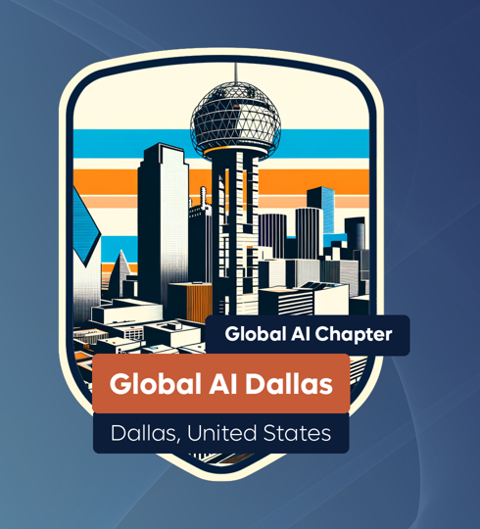


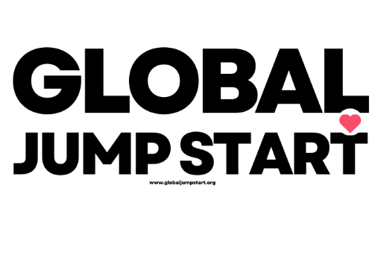
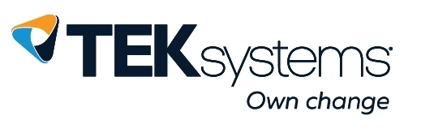

Slide 3

Tim Rayburn
11-time Microsoft MVP (2007-2018)
Open Source Maintainer for Highway Framework
BBQ Fanatic – Feed over 200 people every July 4th at the Improving Dallas office
Soccer Fan – Season ticket holder for FC Dallas, Followed the USWNT through the World Cup playoff rounds in France (2019)
Former Game Store Owner
Avid Magic the Gathering player (Commander)
Former D&D Podcaster (Radio Free Hommlet)
Drone Pilot
Specialization is for Insects.

Slide 4
Where are you?
Anti-AI
Chat about my problem
Agents help me on my tasks
I assign work to Agents and then review
AI runs my life entirely

Slide 5
Where does AI belong in our Enterprises?
Notes:
Empowering AI with Tool Access

Slide 6
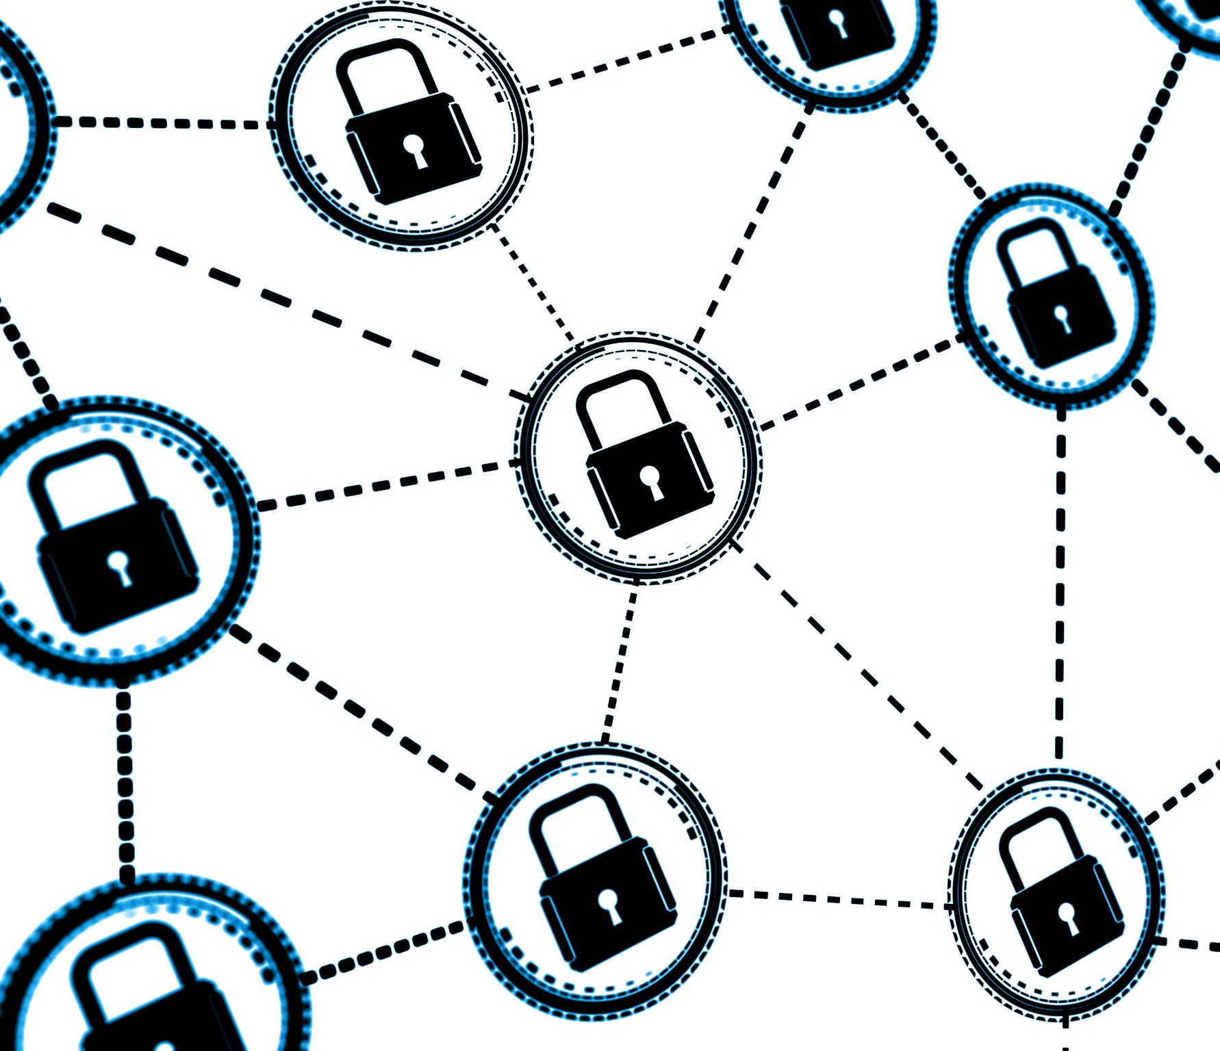
Where does AI Belong?
Notes:
The generative AI revolution has ushered in a new era of capabilities, enabling models to produce text, images, and other content with remarkable fluency. However, the next frontier in AI development is agency—the ability for models to interact with, query, and act upon the world around them. This shift from passive generation to active engagement requires a new approach to tool integration. Traditionally, each AI model needed a custom, often brittle integration for every external tool or data source, leading to the 'N x M integration problem.' This method is not scalable and hinders the broader adoption of AI in real-world applications. To address this, developers are exploring standardized frameworks that allow AI models to access tools like sales leads, code repositories, and IoT devices in a secure and reusable manner. This presentation introduces Anthropic’s Model Context Protocol (MCP), an open-source solution designed to solve these challenges and empower AI agents with robust tool access.

Slide 7
Where does AI Belong?
Notes:
The generative AI revolution has ushered in a new era of capabilities, enabling models to produce text, images, and other content with remarkable fluency. However, the next frontier in AI development is agency—the ability for models to interact with, query, and act upon the world around them. This shift from passive generation to active engagement requires a new approach to tool integration. Traditionally, each AI model needed a custom, often brittle integration for every external tool or data source, leading to the 'N x M integration problem.' This method is not scalable and hinders the broader adoption of AI in real-world applications. To address this, developers are exploring standardized frameworks that allow AI models to access tools like sales leads, code repositories, and IoT devices in a secure and reusable manner. This presentation introduces Anthropic’s Model Context Protocol (MCP), an open-source solution designed to solve these challenges and empower AI agents with robust tool access.

Slide 8
Where does AI Belong?
Compression
Notes:
The generative AI revolution has ushered in a new era of capabilities, enabling models to produce text, images, and other content with remarkable fluency. However, the next frontier in AI development is agency—the ability for models to interact with, query, and act upon the world around them. This shift from passive generation to active engagement requires a new approach to tool integration. Traditionally, each AI model needed a custom, often brittle integration for every external tool or data source, leading to the 'N x M integration problem.' This method is not scalable and hinders the broader adoption of AI in real-world applications. To address this, developers are exploring standardized frameworks that allow AI models to access tools like sales leads, code repositories, and IoT devices in a secure and reusable manner. This presentation introduces Anthropic’s Model Context Protocol (MCP), an open-source solution designed to solve these challenges and empower AI agents with robust tool access.

Slide 9
Where does AI Belong?
Context
Compression
Notes:
The generative AI revolution has ushered in a new era of capabilities, enabling models to produce text, images, and other content with remarkable fluency. However, the next frontier in AI development is agency—the ability for models to interact with, query, and act upon the world around them. This shift from passive generation to active engagement requires a new approach to tool integration. Traditionally, each AI model needed a custom, often brittle integration for every external tool or data source, leading to the 'N x M integration problem.' This method is not scalable and hinders the broader adoption of AI in real-world applications. To address this, developers are exploring standardized frameworks that allow AI models to access tools like sales leads, code repositories, and IoT devices in a secure and reusable manner. This presentation introduces Anthropic’s Model Context Protocol (MCP), an open-source solution designed to solve these challenges and empower AI agents with robust tool access.

Slide 10
Where does AI Belong?
Better Context
Better
Compression
Notes:
The generative AI revolution has ushered in a new era of capabilities, enabling models to produce text, images, and other content with remarkable fluency. However, the next frontier in AI development is agency—the ability for models to interact with, query, and act upon the world around them. This shift from passive generation to active engagement requires a new approach to tool integration. Traditionally, each AI model needed a custom, often brittle integration for every external tool or data source, leading to the 'N x M integration problem.' This method is not scalable and hinders the broader adoption of AI in real-world applications. To address this, developers are exploring standardized frameworks that allow AI models to access tools like sales leads, code repositories, and IoT devices in a secure and reusable manner. This presentation introduces Anthropic’s Model Context Protocol (MCP), an open-source solution designed to solve these challenges and empower AI agents with robust tool access.

Slide 13
Challenges in AI Integration
Notes:
The N x M Integration Problem

Slide 14
How do we integrate with AI?
Custom trained models?
Retrieval Augmented Graphs?
Custom connection to each data source?
We need a standardized interface!

Slide 15
Introducing the Model Context Protocol (MCP)
Notes:
Overview and Architecture

Slide 16
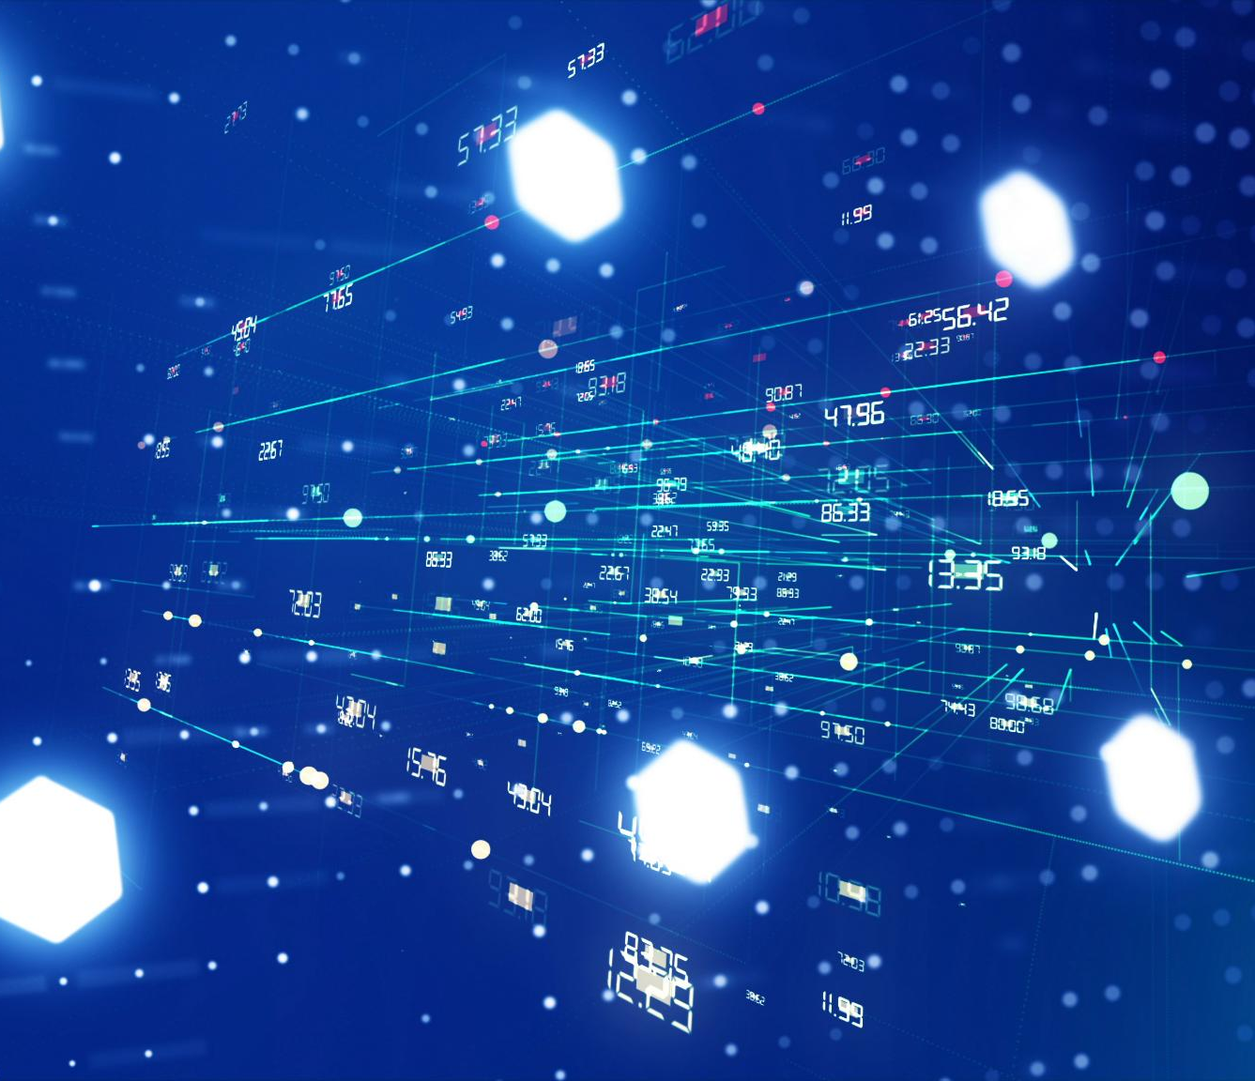
Overview and Architecture
Universal AI Connector
Client-Server Architecture
Standardized Tool Interface
Notes:
The Model Context Protocol (MCP) is an open-source framework developed by Anthropic to address the integration challenges faced by AI models. MCP serves as a universal connector, akin to a USB-C port, that standardizes how AI models discover and use external tools. Unlike simple function-calling mechanisms, MCP introduces a robust client-server architecture that facilitates secure and scalable interactions between AI agents and tools. The protocol defines a consistent interface for tool discovery, invocation, and context management, allowing models to access a wide range of resources without bespoke integrations. MCP supports both pre-built and custom servers, enabling developers to expose proprietary data and APIs in a compliant and secure manner. By adopting MCP, organizations can reduce integration overhead, improve interoperability, and accelerate the development of intelligent, context-aware AI agents. This architecture lays the foundation for a new ecosystem where tools and models can interact seamlessly, fostering innovation and collaboration across the AI community.

Slide 17

Visual Studio Code
LLMs
Visual Studio 2022
Claude Sonnet
IntelliJ
Uses
GPT5
JetBrains Rider
Gemini
MCP Client

Slide 18
Visual Studio Code
LLMs
Visual Studio 2022
Claude Sonnet
IntelliJ
GPT5
JetBrains Rider
Gemini
Uses
Developer CLI
Cursor CLI
Gemini CLI
Copilot CLI
MCP Client

Slide 19
Agent
(MCP Client)
Uses
Model

Slide 20
Agent
(MCP Client)
Model
Consider Tools
Plan / Reason
Invoke Tools
MCP Server(s)
Tools

Slide 21
GitHub Remote Server
Demonstration

Slide 22
Scryfall MCP Server
Demonstration

Slide 23
Benefits of Standardized AI Integration
Notes:
Creating a Collaborative Ecosystem

Slide 24
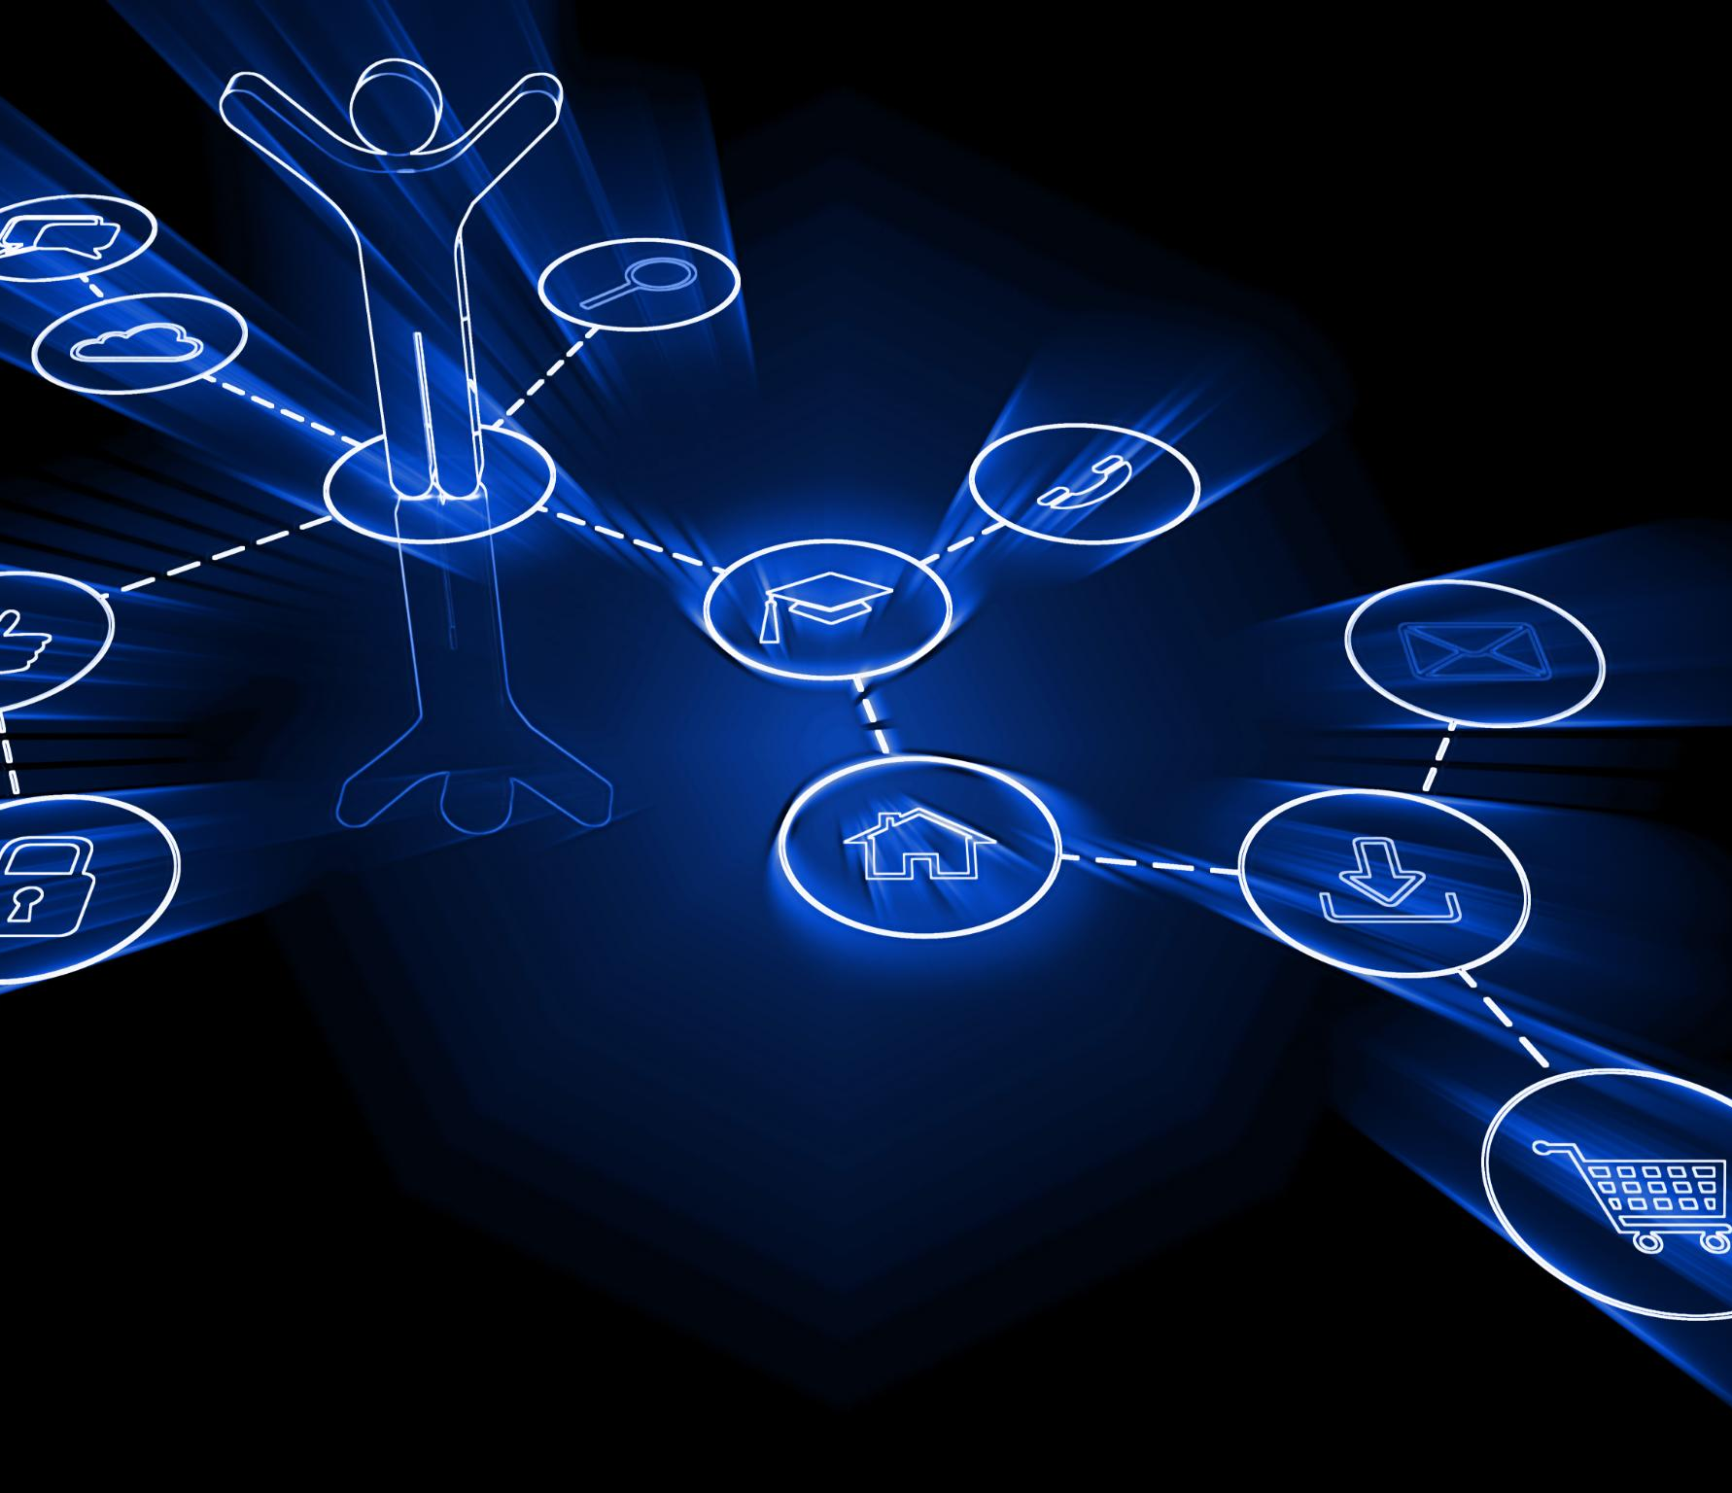
Creating a Collaborative Ecosystem
Efficiency Through Standardization
Standard protocols reduce reliance on bespoke connectors, saving time and improving reliability in AI tool integration.
Collaborative Developer Community
Sharing tools and best practices fosters innovation and accelerates progress across the AI community.
Enhanced Security and Compliance
Consistent authentication and data access mechanisms improve security and regulatory compliance.
Intelligent, Actionable Agents
Standardization enables AI agents to understand context, generate content, and take meaningful actions.
Notes:
Standardizing AI tool integration through protocols like MCP offers numerous benefits that extend beyond individual projects. First, it reduces the need for bespoke connectors, saving time and resources while improving reliability. Second, it fosters a collaborative ecosystem where developers can share tools, servers, and best practices, accelerating innovation across the AI community. Third, it enhances security and compliance by providing consistent mechanisms for authentication and data access. MCP’s open-source nature encourages transparency and community contributions, leading to continuous improvement and broader adoption. By aligning on a common protocol, organizations can ensure that their AI models are compatible with a wide range of tools and environments, facilitating interoperability and scalability. This standardization also supports the development of intelligent agents that are not only capable of understanding and generating content but also of taking meaningful actions. In essence, MCP transforms AI from a passive technology into an active participant in digital ecosystems, paving the way for the next generation of context-aware, tool-enabled agents.

Slide 25
Playwright MCP Server
Demonstration

Slide 26
Conclusion and Call to Action
Notes:
Building the Next Generation of AI Agents

Slide 27
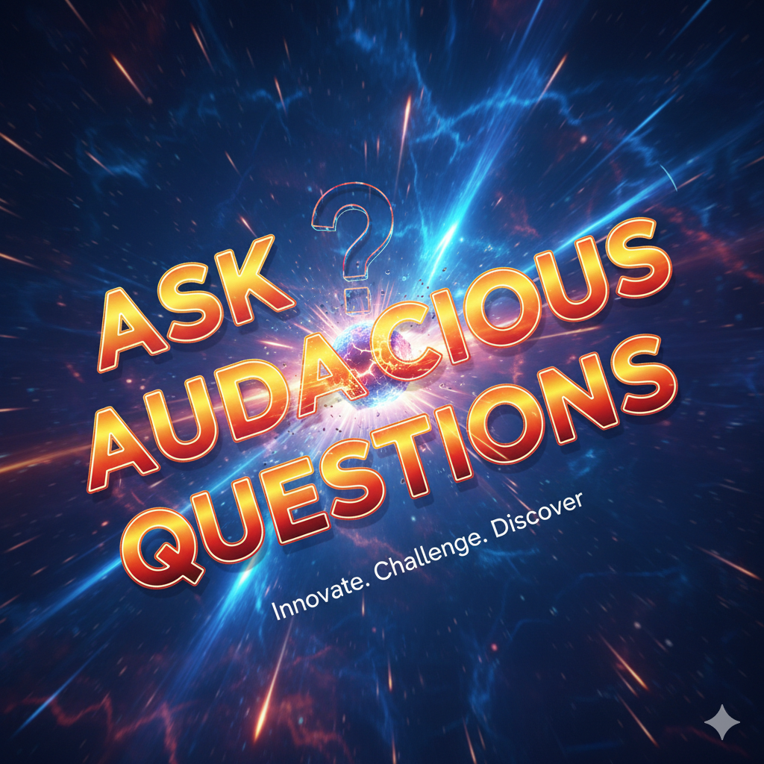
Stop putting AI in a box.
Notes:
The journey from generative AI to agentic AI represents a significant evolution in the field. By adopting the Model Context Protocol, developers can move beyond building one-off connectors and start creating intelligent agents that interact with the world in meaningful ways. MCP provides the tools and standards necessary to integrate AI models with external resources securely and efficiently. This session has introduced the core concepts of MCP, demonstrated its practical applications through pre-built and custom servers, and highlighted the benefits of standardized integration. Developers are encouraged to explore MCP, contribute to its ecosystem, and leverage its capabilities to build AI agents that don’t just talk, but act. The future of AI lies in its ability to understand context, make decisions, and perform tasks autonomously. MCP is a foundational step toward realizing this vision, and by embracing it, developers can play a pivotal role in shaping the next generation of AI technology.

